Slide 1
Armed Intruder Scenario Discussion

Slide 2
Purpose
While the likelihood of an armed intruder in our school is incredibly low (you have a better chance of being hit by lightning twice), we want you to be prepared in case you ever find yourself in a situation here, or anywhere.
Like many athletes who visualize their success, if you visualize and think about what you can do before a situation arises, you will react quicker and already have a plan in place if you are confronted with that scenario.
As we cannot practice for every single situation, scenarios have been created to encourage you to start thinking about what you can do in different situations.

Slide 3
Scenario #1
You are in the library during 2nd period.
There is a report of gunfire in the hallway of upper D unit.
What do you do?

Slide 4
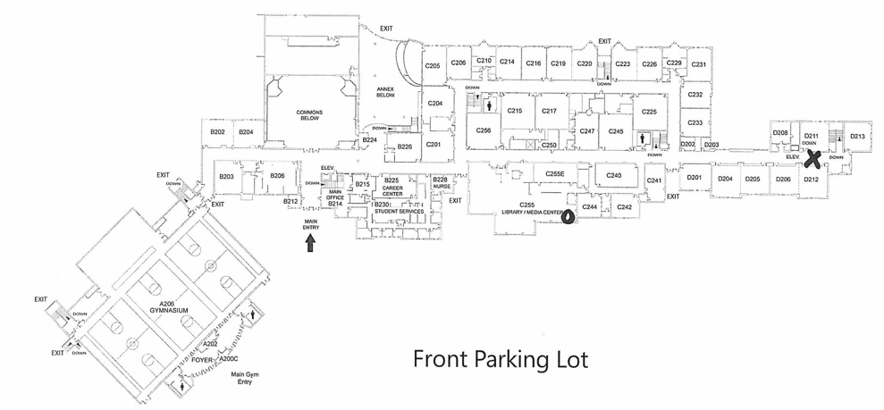
O - Your location
X - Armed Intruder location

Slide 5
Scenario #2
You are in the room C124 during 1st period.
There is a report of gunfire in the hallway just down the hallway near C115.
What do you do?

Slide 6
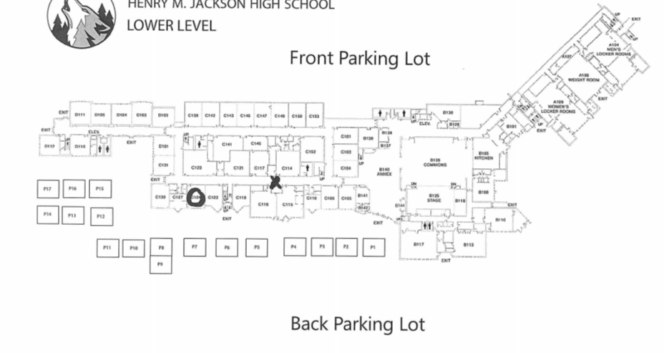
O - Your location
X - Armed Intruder location

Slide 7
Scenario #3
You are at lunch.
You hear gunfire in the commons.
What do you do?

Slide 8
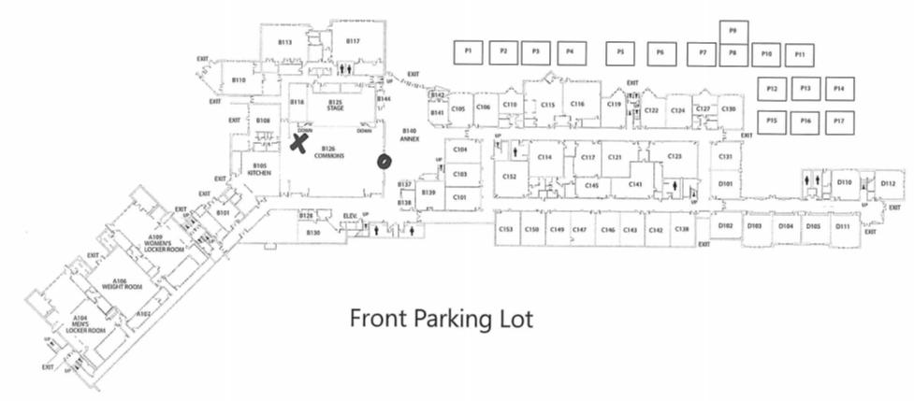
O - Your location
X - Armed Intruder location

Slide 9
Scenario #4
You are going to the bathroom during 6th period.
You hear gunfire just outside the bathroom in the hallway.
What do you do?

Slide 10
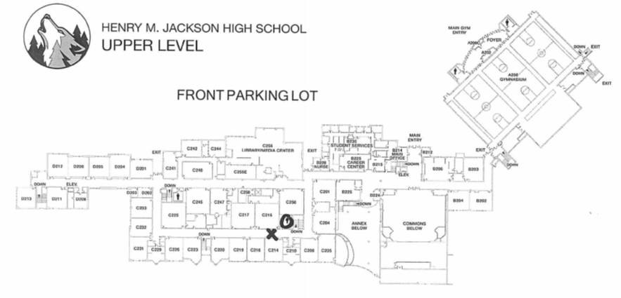
O - Your location
X - Armed Intruder location

